Slide 1
Linear Algebra and Descriptive statistics

Slide 2
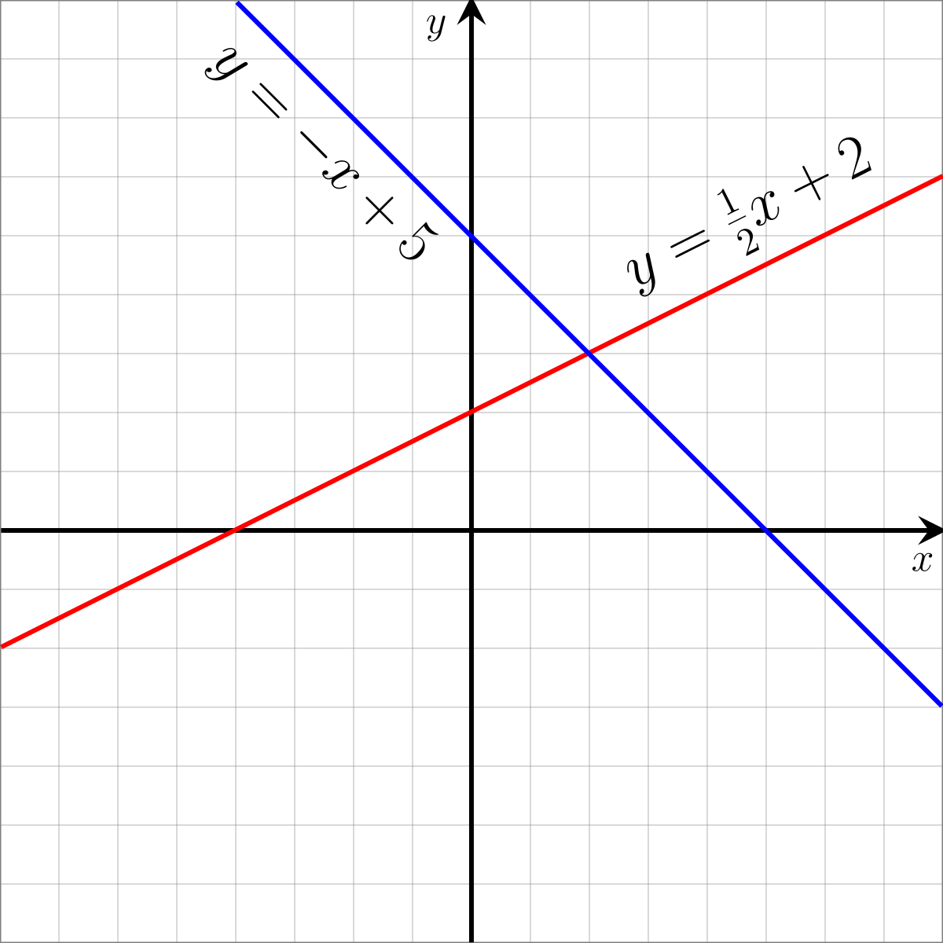
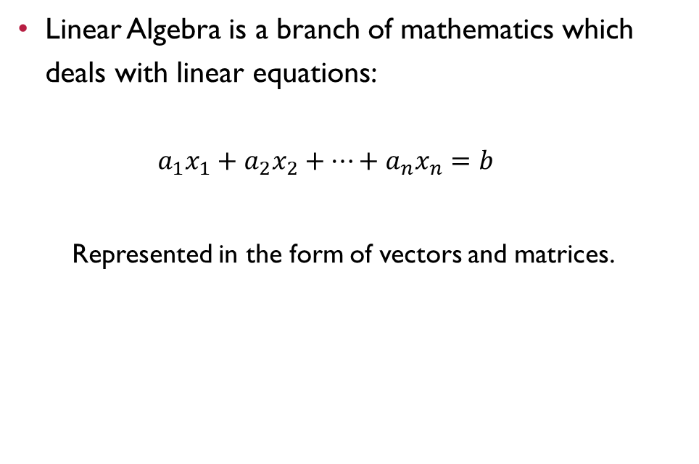
Linear Algebra
Linear Algebra is a branch of mathematics which deals with linear equations:
$$a_{1}x_{1}+a_{2}x_{2}+⋯+a_{n}x_{n}=b$$
Represented in the form of vectors and matrices.

Slide 3

Linear algebra in python
The main package for linear algebra in python is ‘SCIPY’ which builds on ‘NUMPY’ therefore both of the libraries are imported.
The ‘numpy’ library is used to create the arrays and perform the array operations of python while the ‘scipy’ library is use to perform linear algebraic operations

Slide 4
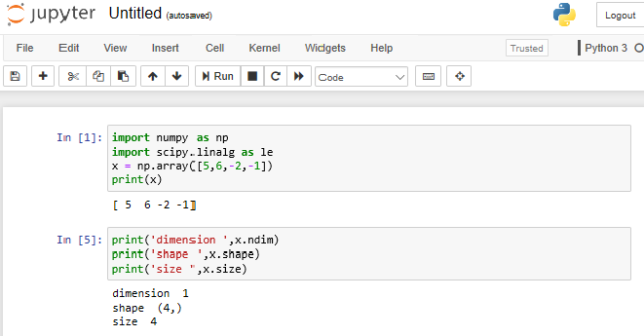
Creating and operating on 1-d array

Slide 5
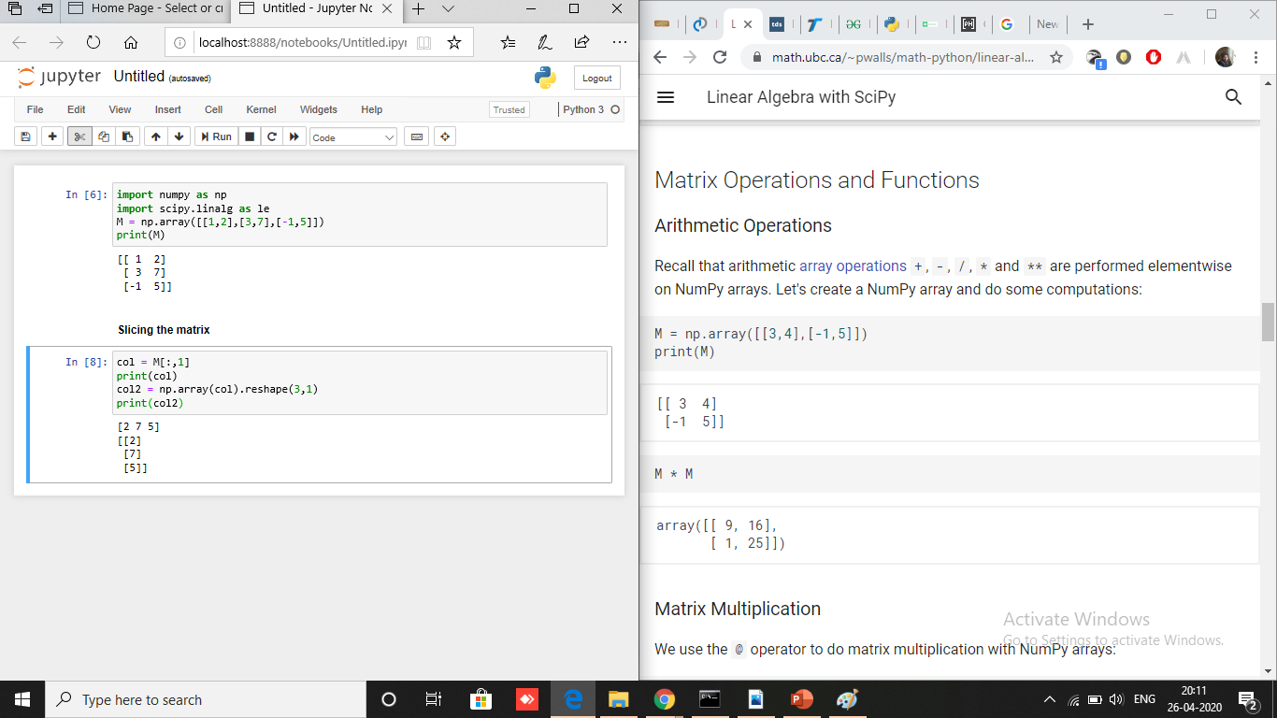
Creating and operating on 2-D array

Slide 6
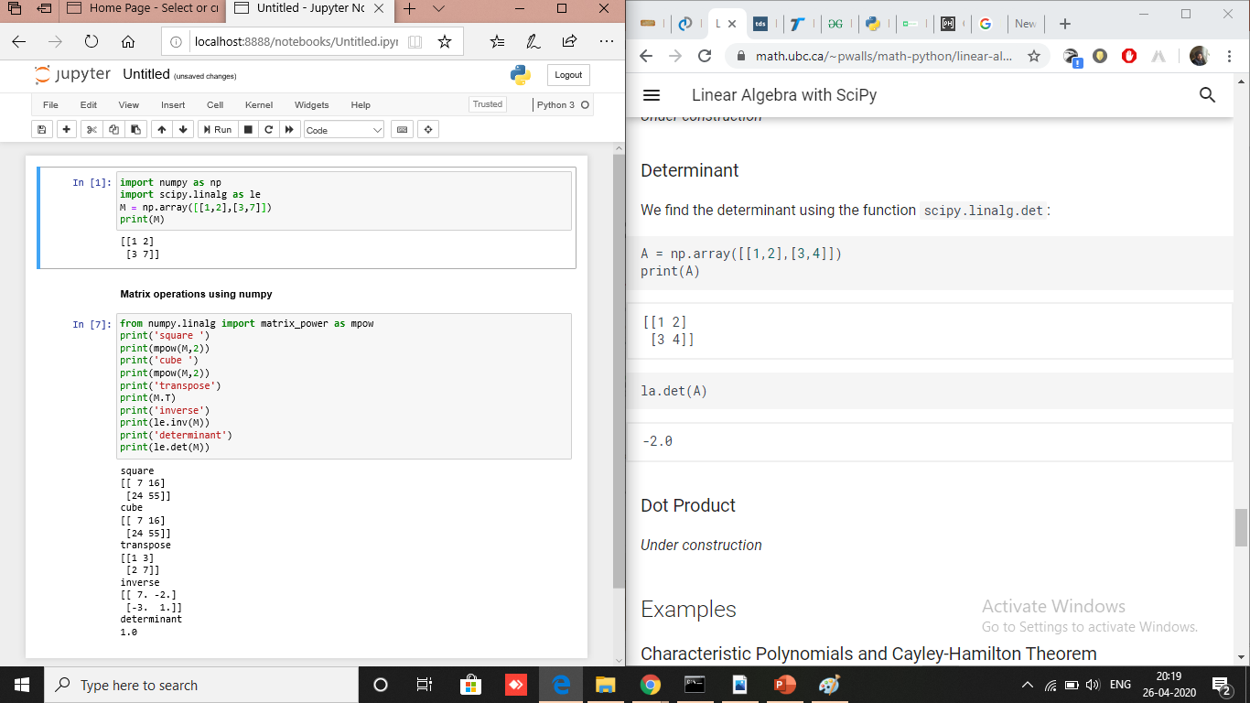
Advanced matrix operations(1/2)

Slide 7
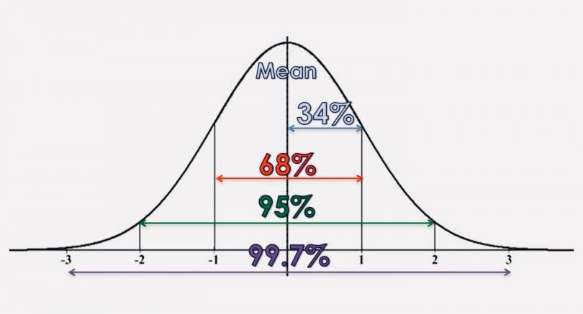
descriptive statistics
Descriptive statistics uses tools like mean and standard deviation on a sample to summarize data.
Central tendency is described by median, mode, and the means.
Dispersion is the degree to which data is distributed around this central tendency, and is represented by range, deviation, variance, standard deviation and standard error.

Slide 8
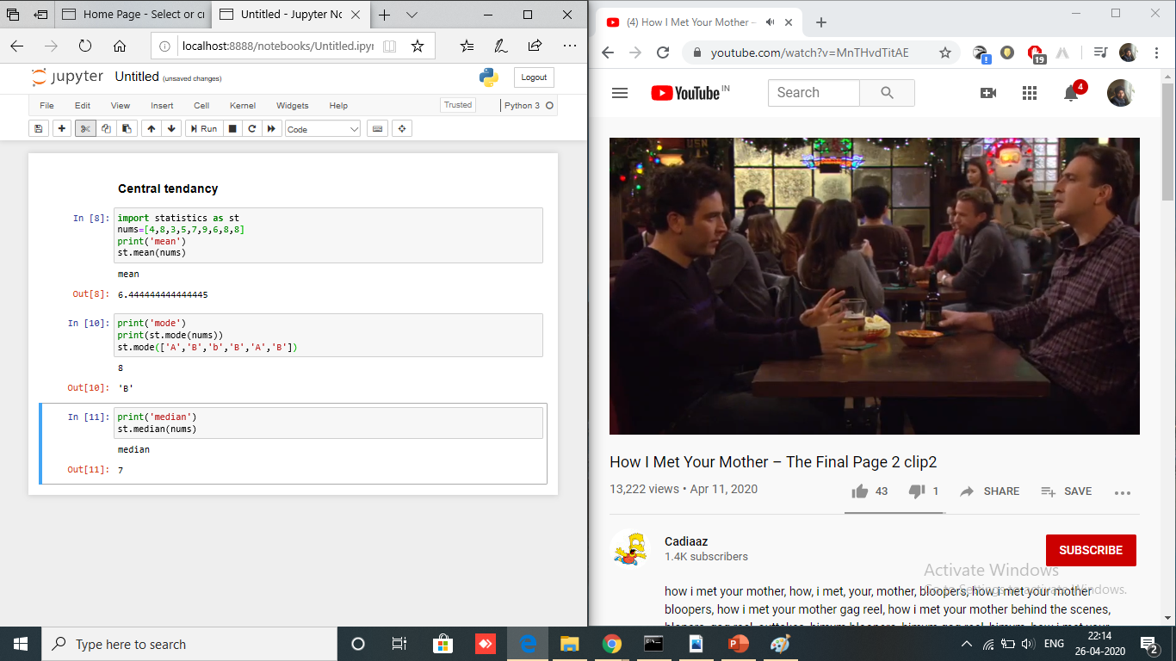
Descriptive statistics in python(1/2)

Slide 9
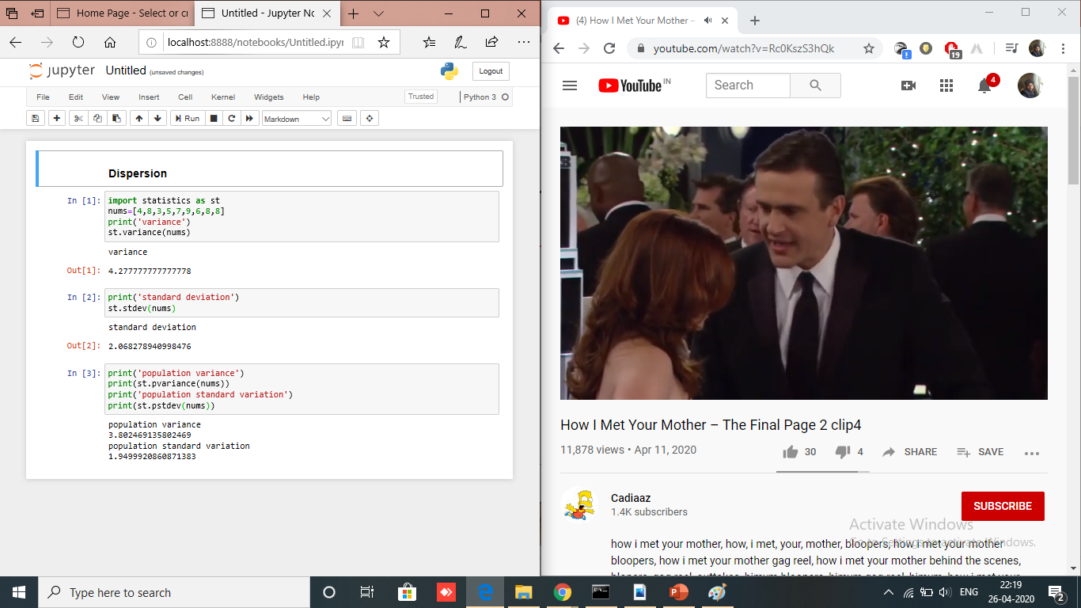
Descriptive statistics in python(2/2)

Slide 10
Thank you

